Slide 1
From Data to Information
Will Doyle
@wdoyle42

Slide 2
Three Principles for Moving from Data to Information
Focus on People
Make Comparisons
Evaluate

Slide 3
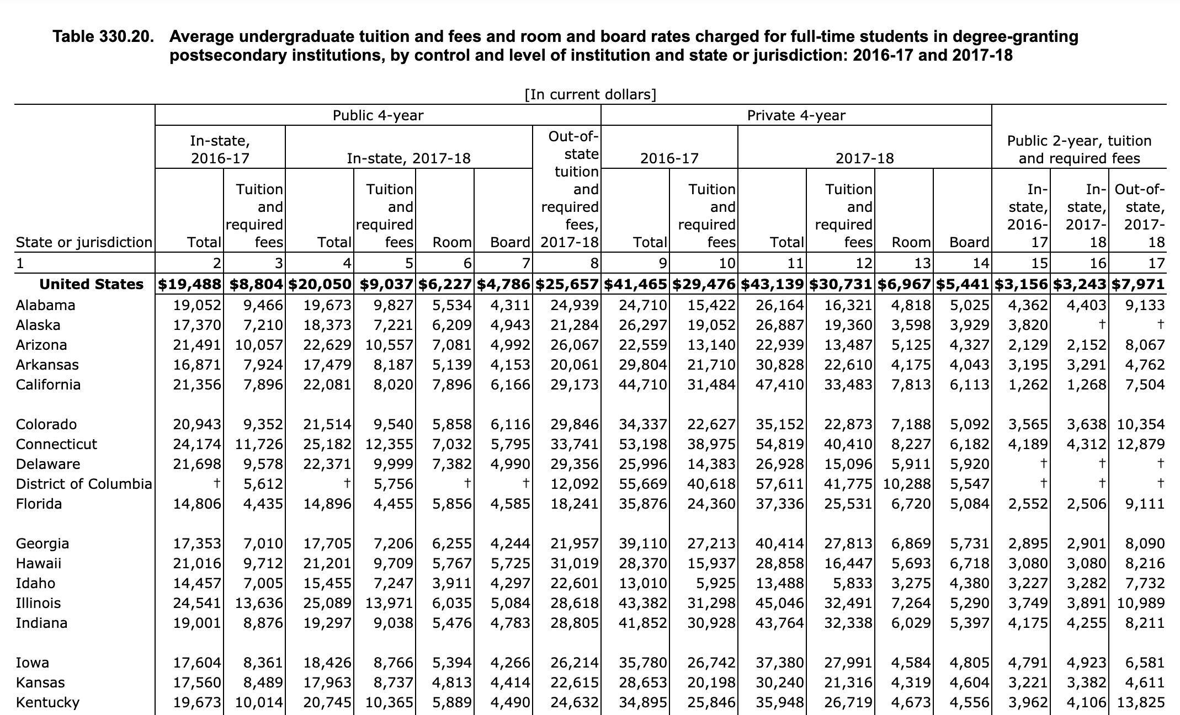
Focus on People
Source: Digest of Education Statistics:https://tinyurl.com/y2mob4vn

Slide 4
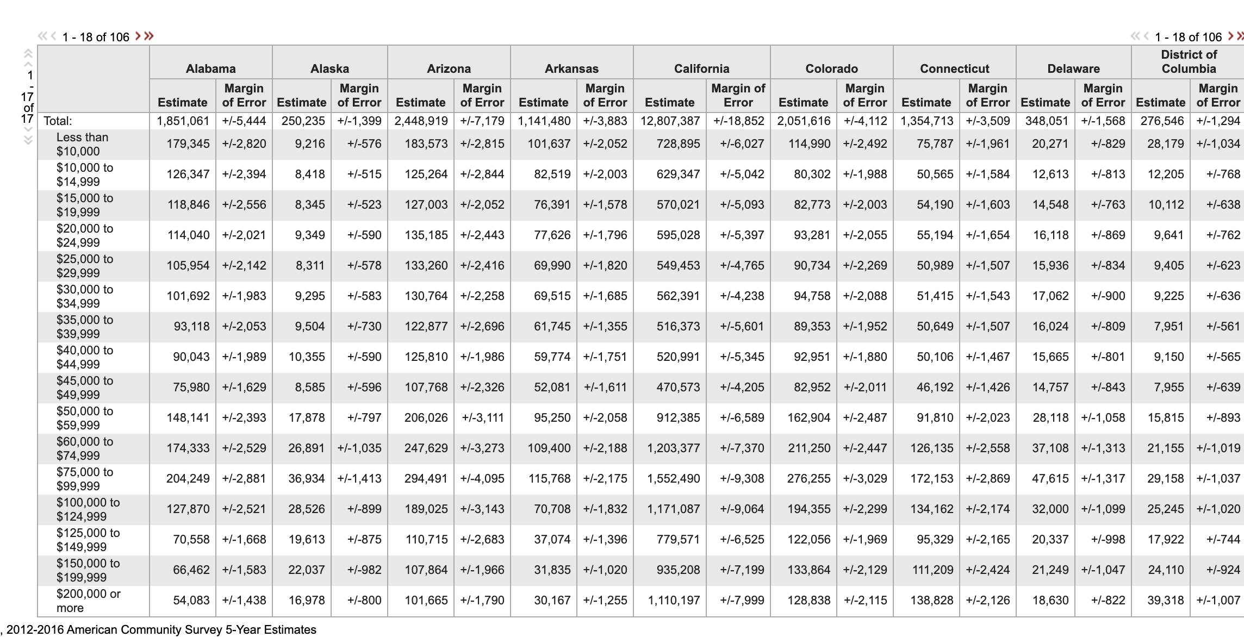
Focus on People
Source: Census Bureau: https://tinyurl.com/j2348jk

Slide 5
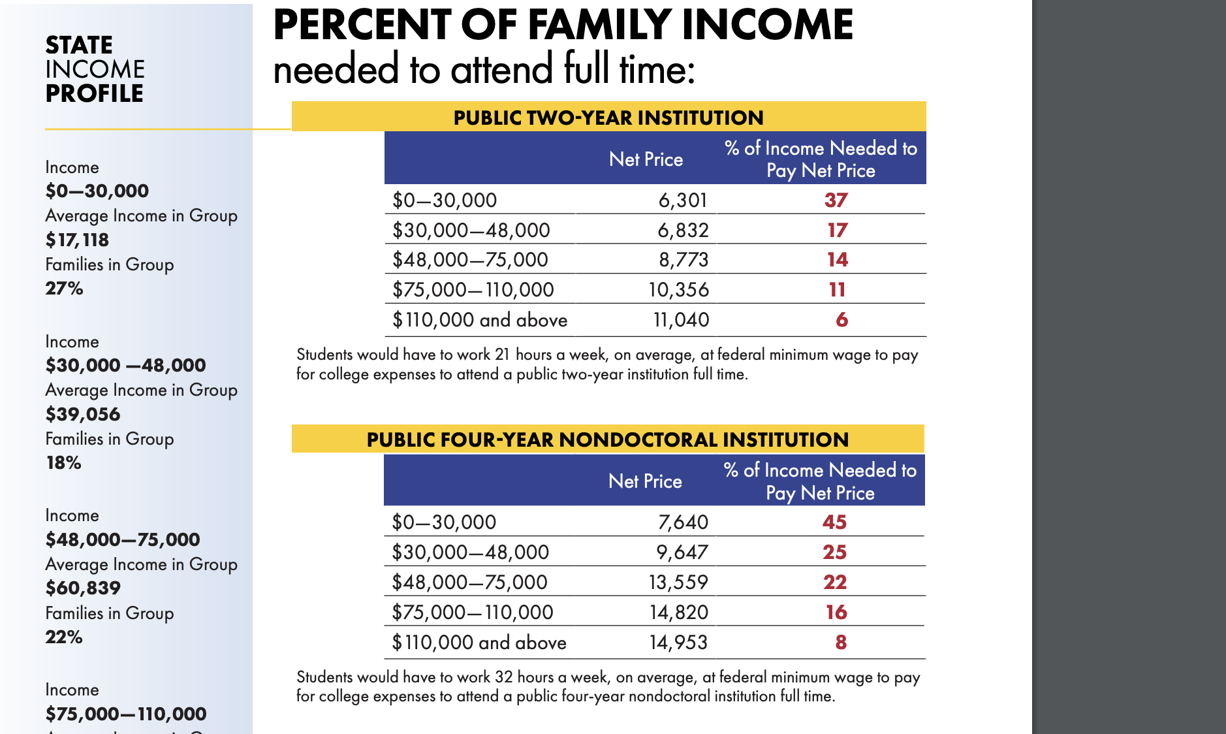
Focus on People
Source: PENN IRHE, https://tinyurl.com/y32bckfm

Slide 6
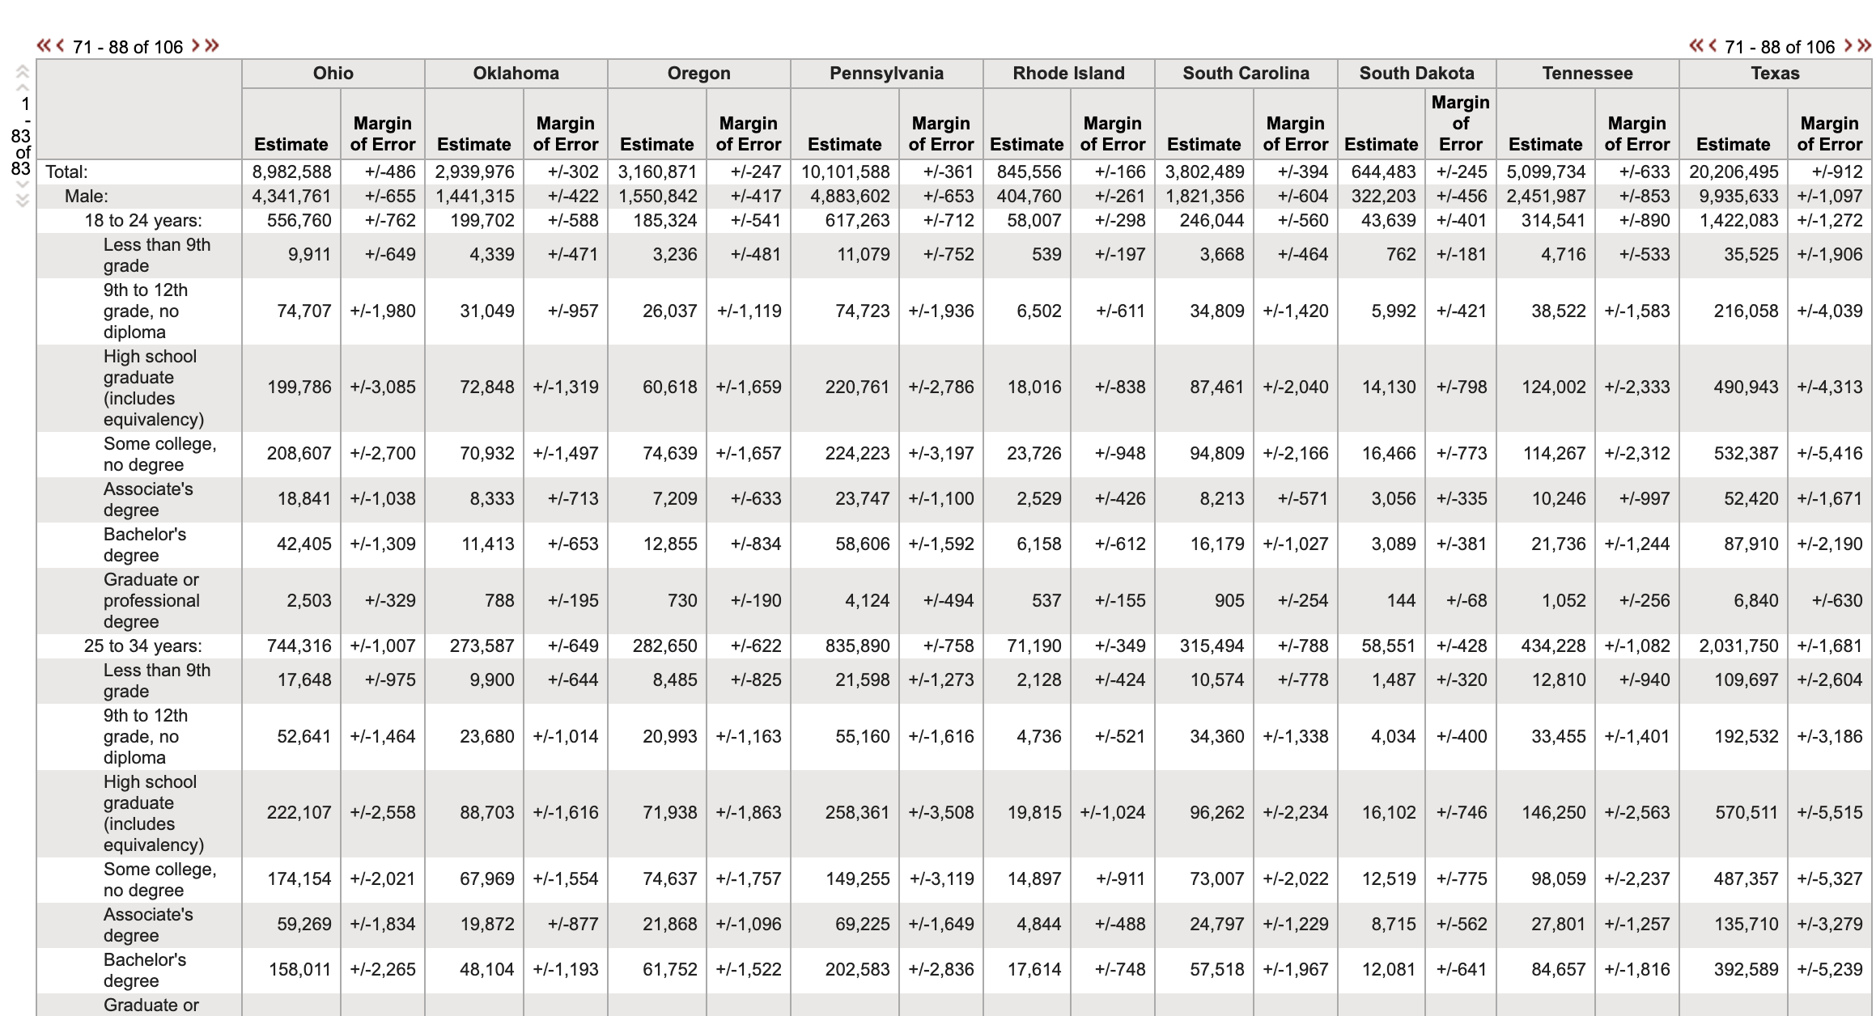
Make Comparisons
Source: Census Bureau, https://tinyurl.com/yxgytsxb

Slide 7
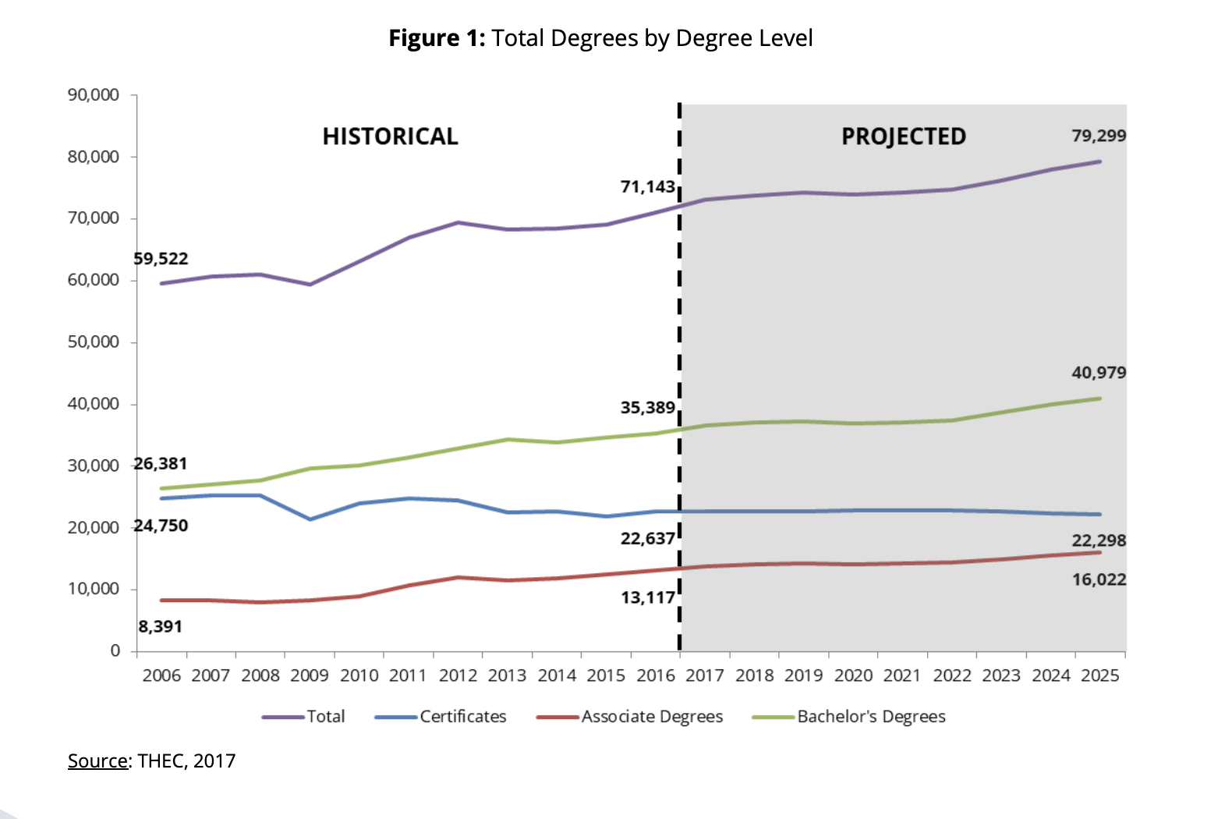
Make Comparisons
Source: THEC, https://tinyurl.com/yxqkuupz

Slide 8
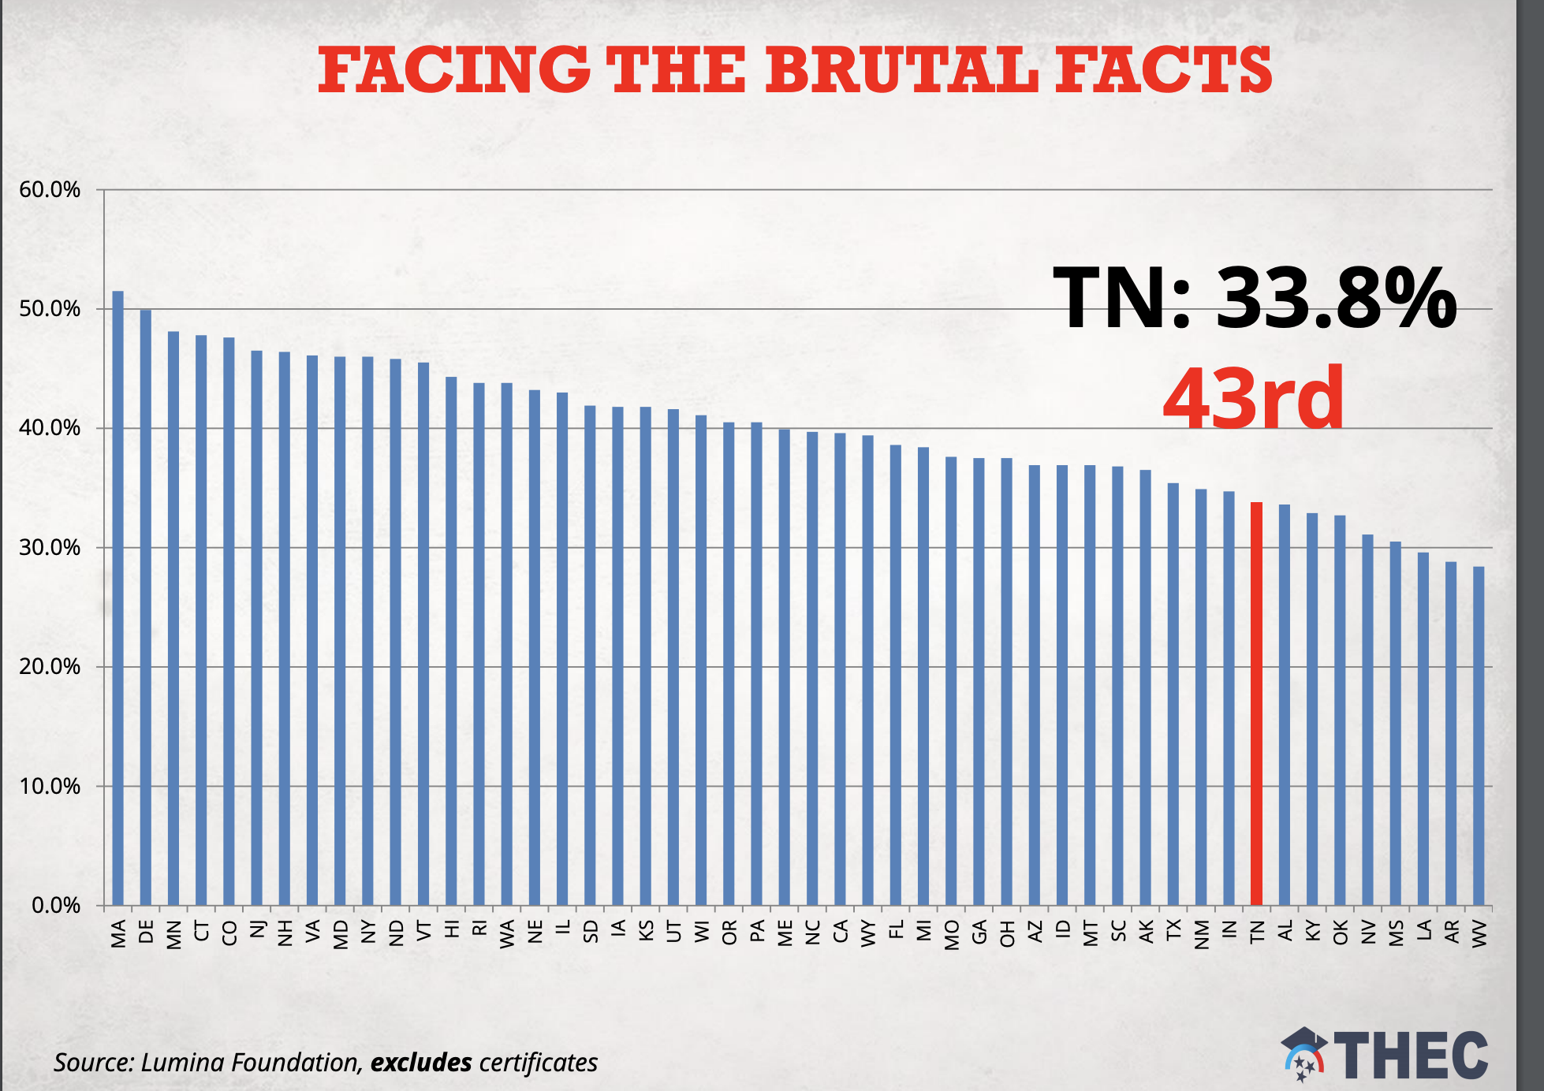
Make Comparisons
Source; THEC: https://tinyurl.com/yxtn4xaj

Slide 9
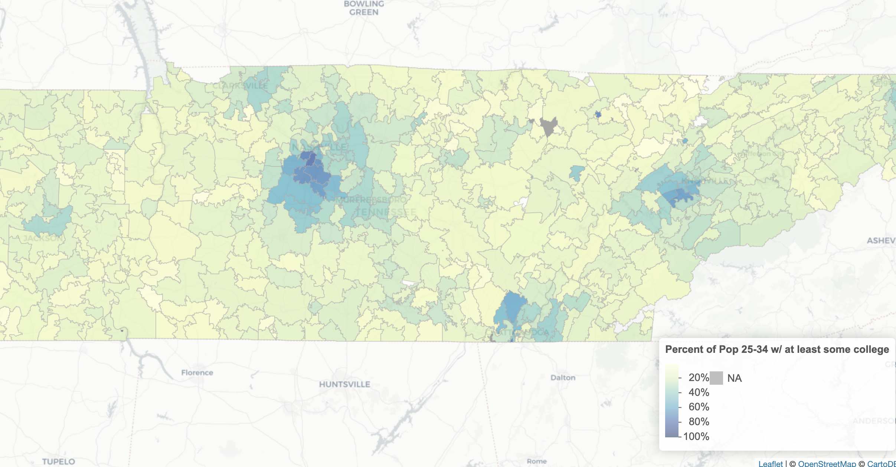
Make Comparisons
Percent of the Population aged 25-34 with at least some college
Source: American Community Survey, 2018

Slide 10
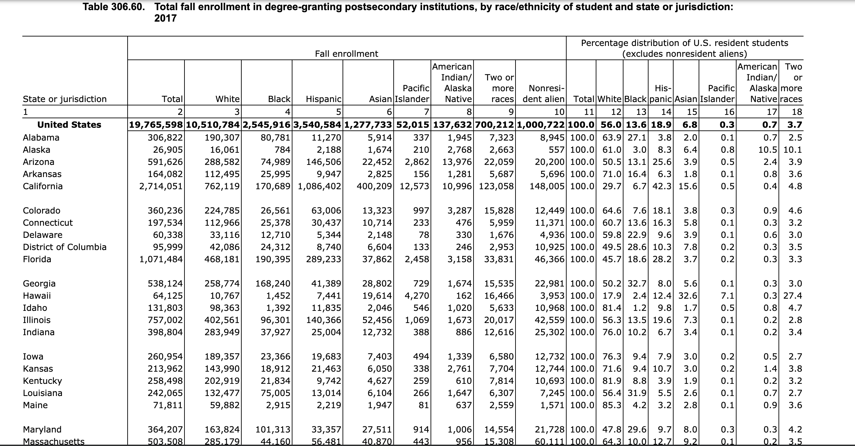
Evaluate
Source: Digest of Education Statistics: https://tinyurl.com/yycej64t

Slide 11
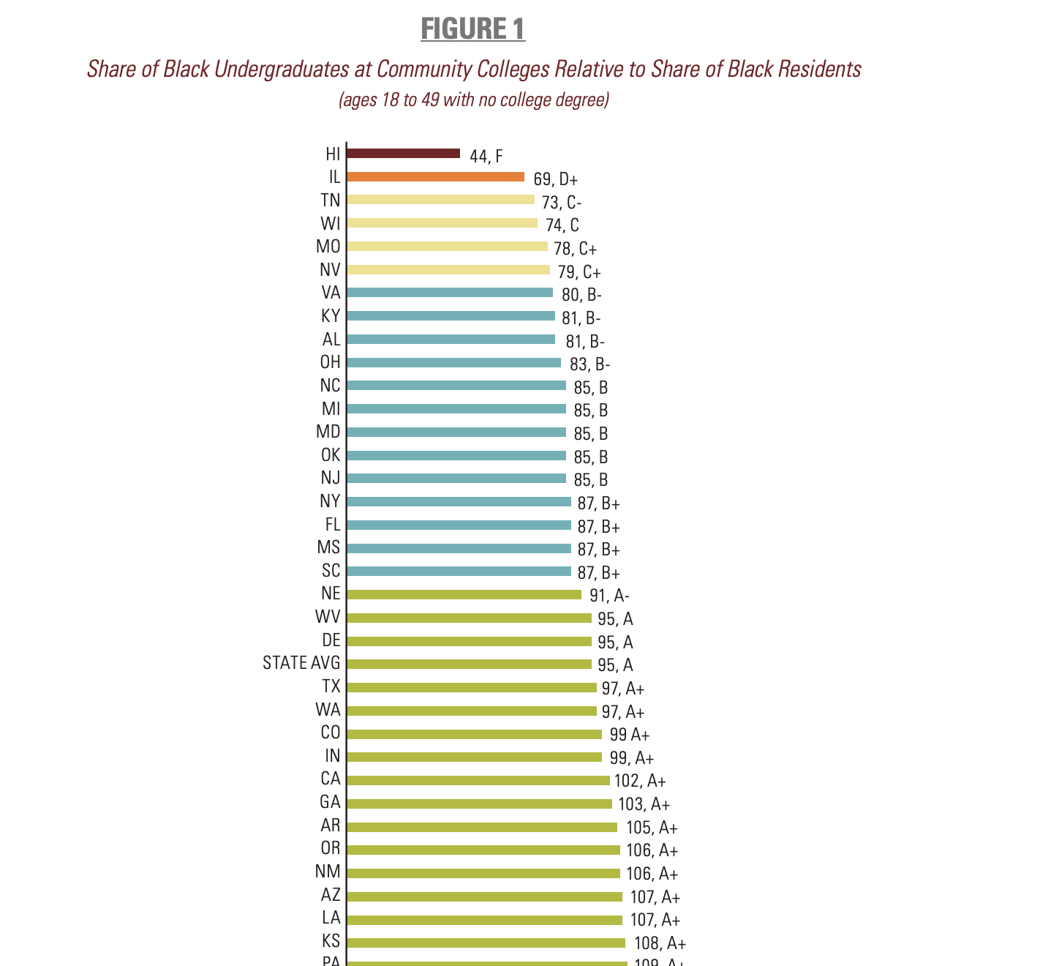
Evaluate
Source: Education Trust, 2018: https://tinyurl.com/y4rnj8u6

Slide 12
w.doyle@Vanderbilt.edu
@wdoyle42

